Slide 1






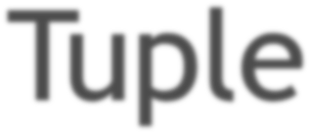
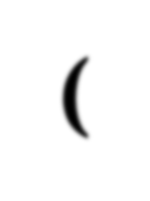
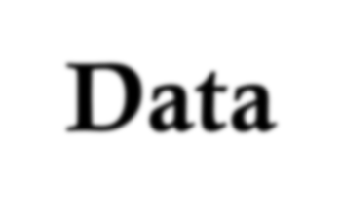
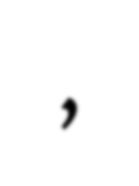
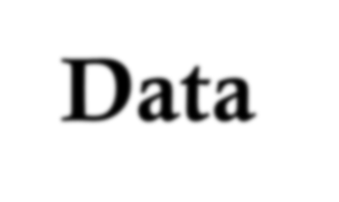

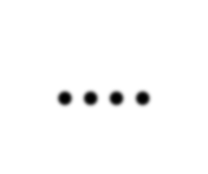
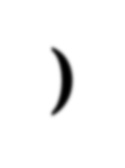
(Data , Data , Data , Data , ….)
1

Slide 2
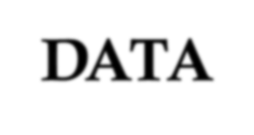
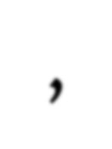
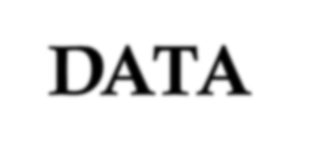

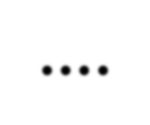
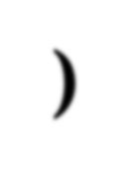


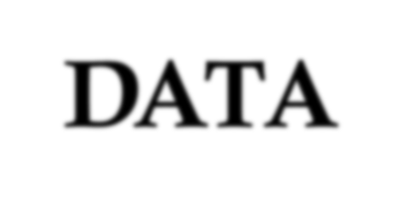


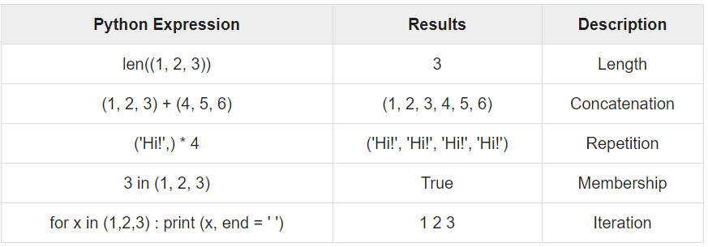

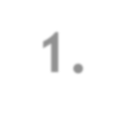
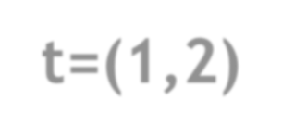
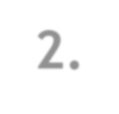
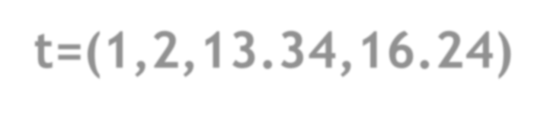
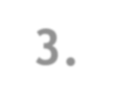
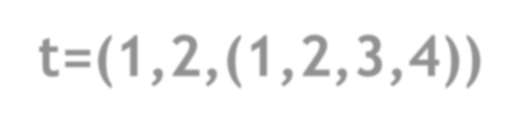
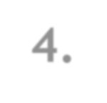
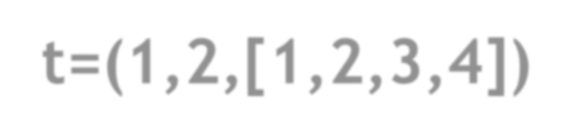
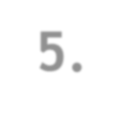
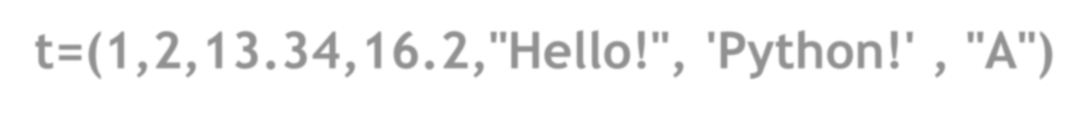
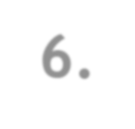
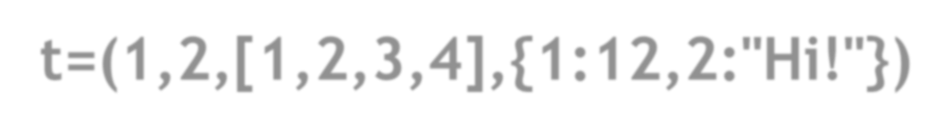
Tuple
Tuple_VN= ( DATA , DATA , DATA , DATA , ….)
DATA
NUMBER , STRING, FLOAT, TUPLE, LIST, DICTIONARY
1. t=(1,2)
2. t=(1,2,13.34,16.24)
3. t=(1,2,(1,2,3,4))
4. t=(1,2,[1,2,3,4])
5. t=(1,2,13.34,16.2,"Hello!", 'Python!' , "A")
6. t=(1,2,[1,2,3,4],{1:12,2:"Hi!"})

Slide 3

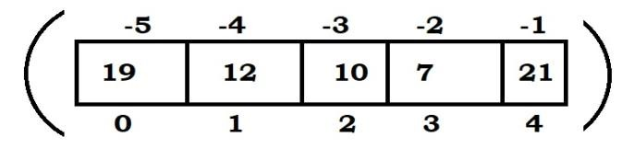

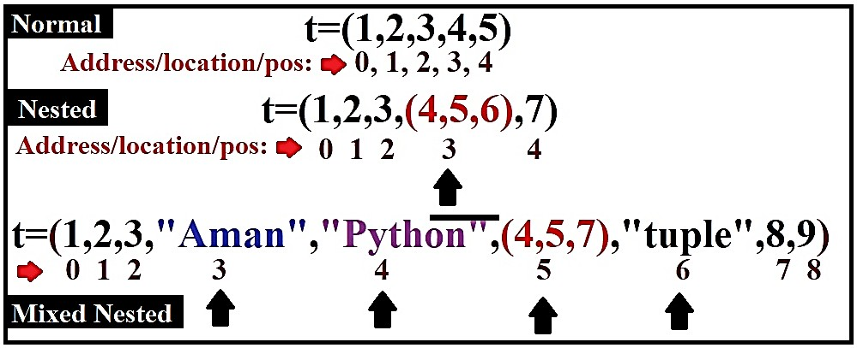
TUPLE INDEXING

Slide 4
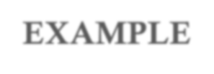


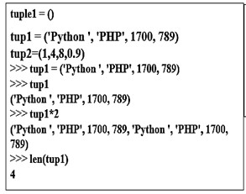
TUPLE EXAMPLE

Slide 5


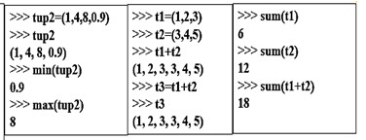
TUPLE EXAMPLE

Slide 6
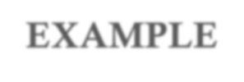


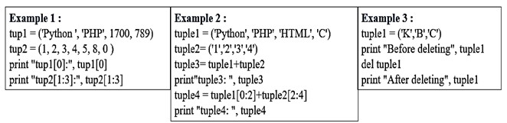
TUPLE EXAMPLE

Slide 7





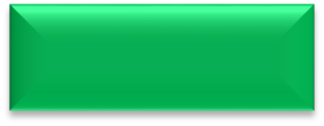
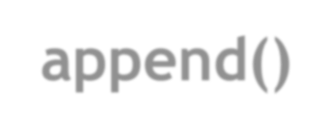




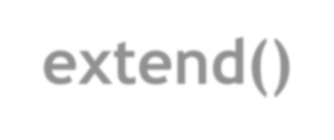
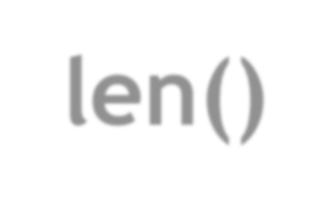
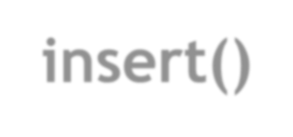
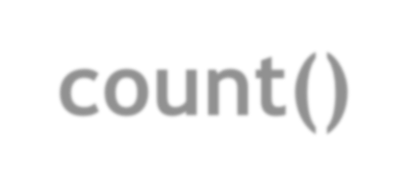
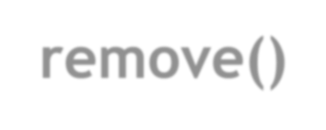
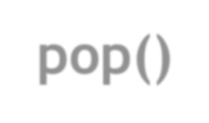
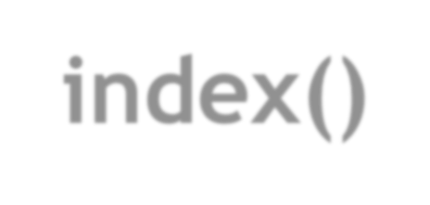
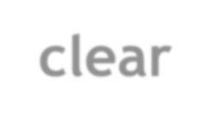
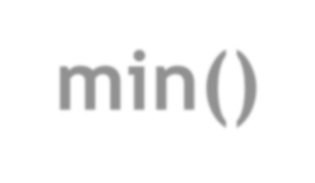
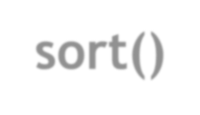
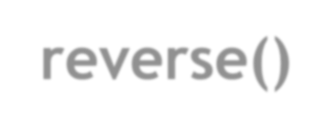
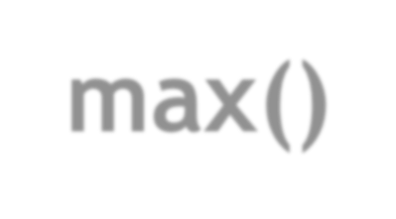
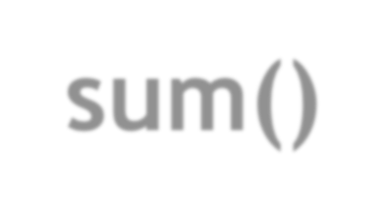
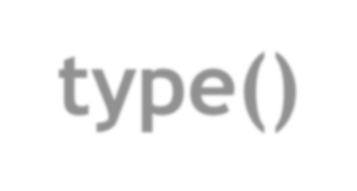
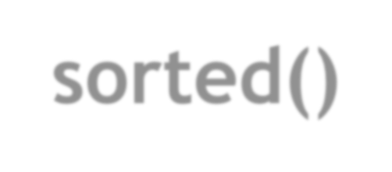

Tuple Functions
append() extend()
len() count() index() min()
max()
sum()
type() sorted()
t=(1,2,4,2,6,8,2,9)
insert()
print(len(t)) 8
remove()
print(t.count(2)) 3
print(t.index(8)) 5
pop() clear sort()
print(min(t))
print(max(t))
print(sum(t)) print(type(t)) print(sorted(t))
1
9
34
<class 'tuple'>
reverse()
[1, 2, 2, 2, 4, 6, 8, 9]
8

Slide 8







1. Consider the following tuple:
monuments=[ ' Kutub Minar', 10, ' Taj Mahal', 20, 'India Gate', 30, 'Char Minar', 40] states=['Delhi', 'Kerala', 'Tamil Nadu', 'Bihar']
Write Python statements for the following. Kindly state the reason for the operations which not possible.
To insert “Red Fort” and “Jantar Mantar” in the tuple monuments
To add 50 at the end of the tuple
To add tuple of states at the end of the tuple of monuments
To replace 3rd, 4th and 5th element of the monuments tuple by “India”.
To remove the third element from the tuple monuments.
To delete the tuple monuments.
To store all elements 2 times in the tuple states.
To check whether the element 20 is present in the tuple or not.
To swap the elements of tuples, monuments and states.
Tuple
10. To display all elements of a tuple states in different lines.
2. Consider the tuples planets and states and give the output of the following Python statements: planets=['Mercury', 'Venus', 'Earth', 'Mars', 'Jupiter', 'Saturn', 'Uranus', 'Neptune'] states=['Delhi', 'Kerala', 'Tamil Nadu', 'Bihar', 'Delhi']
planets=planets+”Tamil”
Programs
states=states*2 len(planets) max(planets) min(planets) count(‘Delhi’)
Write Python script to display the element with maximum value from the given tuple.
Write Python script to display the element with minimum value from the given tuple.
Write Python script to display the sum of elements from the given tuple of numbers.
Write Python script to display the average of elements from the given tuple of numbers.
Write a Python script to input a tuple with names of dance forms. Input a dance form and add this
dance form at end of the touple.
9

